Slide 1
About Us
The design room was established in Pune in 2014. We create transformative, cultural, corporate,residential and other spaces that work with clients personal philosophy and personal surroundings.
We believe that every project has to be handled very carefully taking into account the client brief, their tastes, their lifestyles, requirements, fidelity to site conditions, the time and the economic frame for the same.

Slide 2
About Us
We design projects that are practical as well as aesthetically appealing. We spend lot of time and energy into understanding the life style and the culture of the occupants who are going to inhibit the space.
A keen sense of aesthetics and visual appeal along with discipline in the design is the key factor of our work. We believe in creating spaces that the owner is comfortable with and relates to as his own.

Slide 3
Core Values
Design innovation – We strive to ensure that each one of our works are unique , like our clients business.
To ensure that the client gets the best possible design solution every time
The highest standards of professional integrity.
Transparent communications.
Appropriate cost effective design solution.

Slide 4
Services
We provide following services:
Residential : we undertake interior designing for residential spaces like premium residences, studio apartments, bunglows, pent houses, etc.
Commercial : it includes hotels, restaurants and bars, offices, retail shops, spa’s and salons, IT companies,boutiques.
Others: it includes online Interior designing services and consultation and 3D visualization.

Slide 5
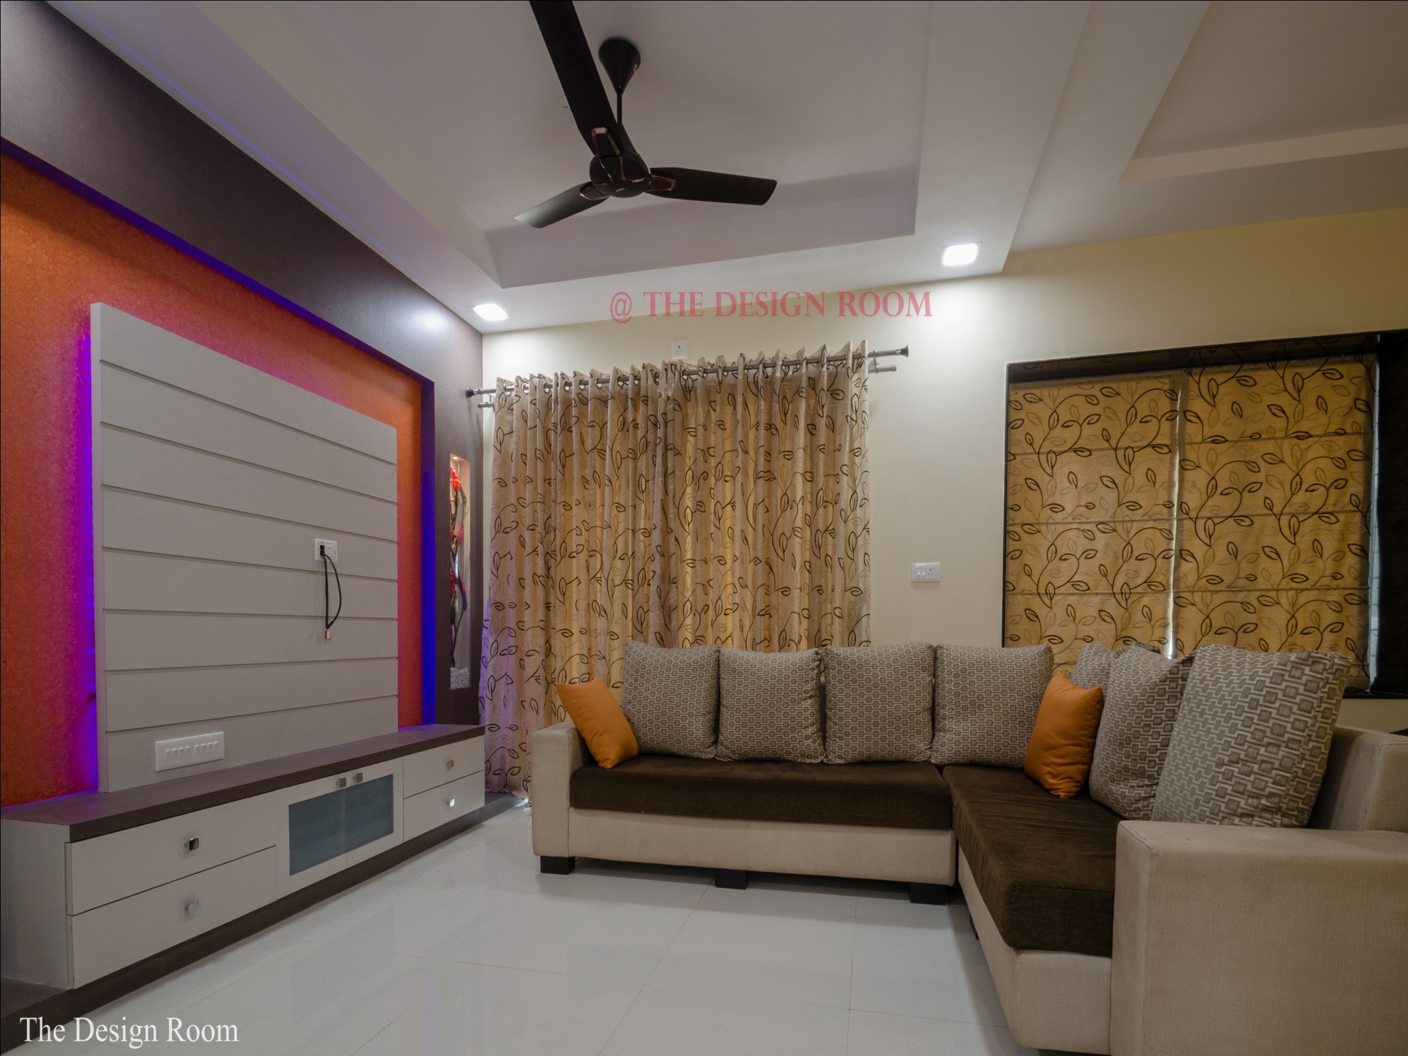

Slide 6
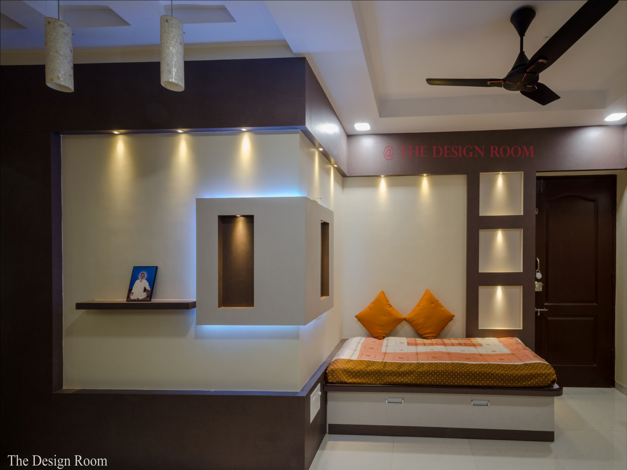

Slide 7
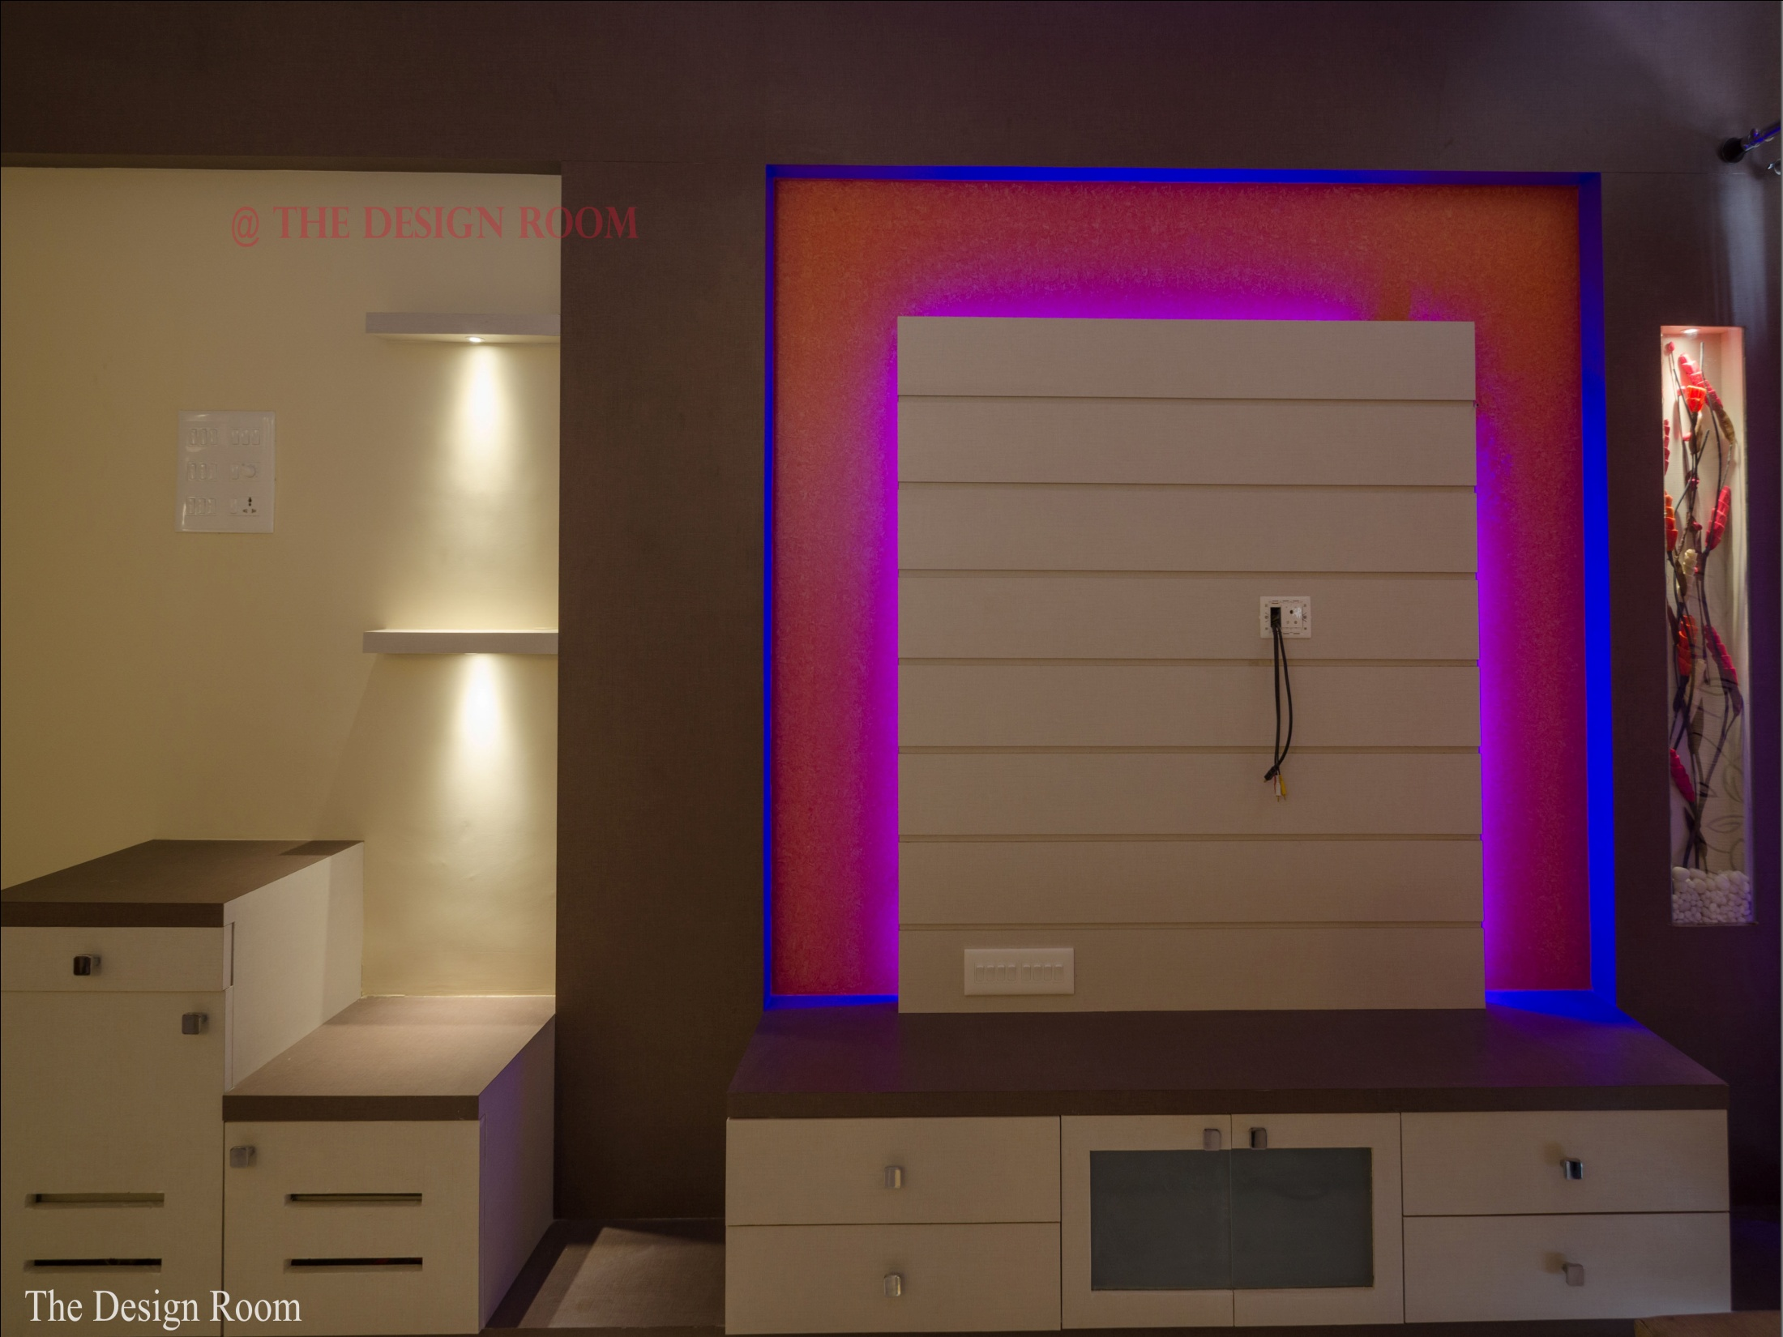

Slide 8
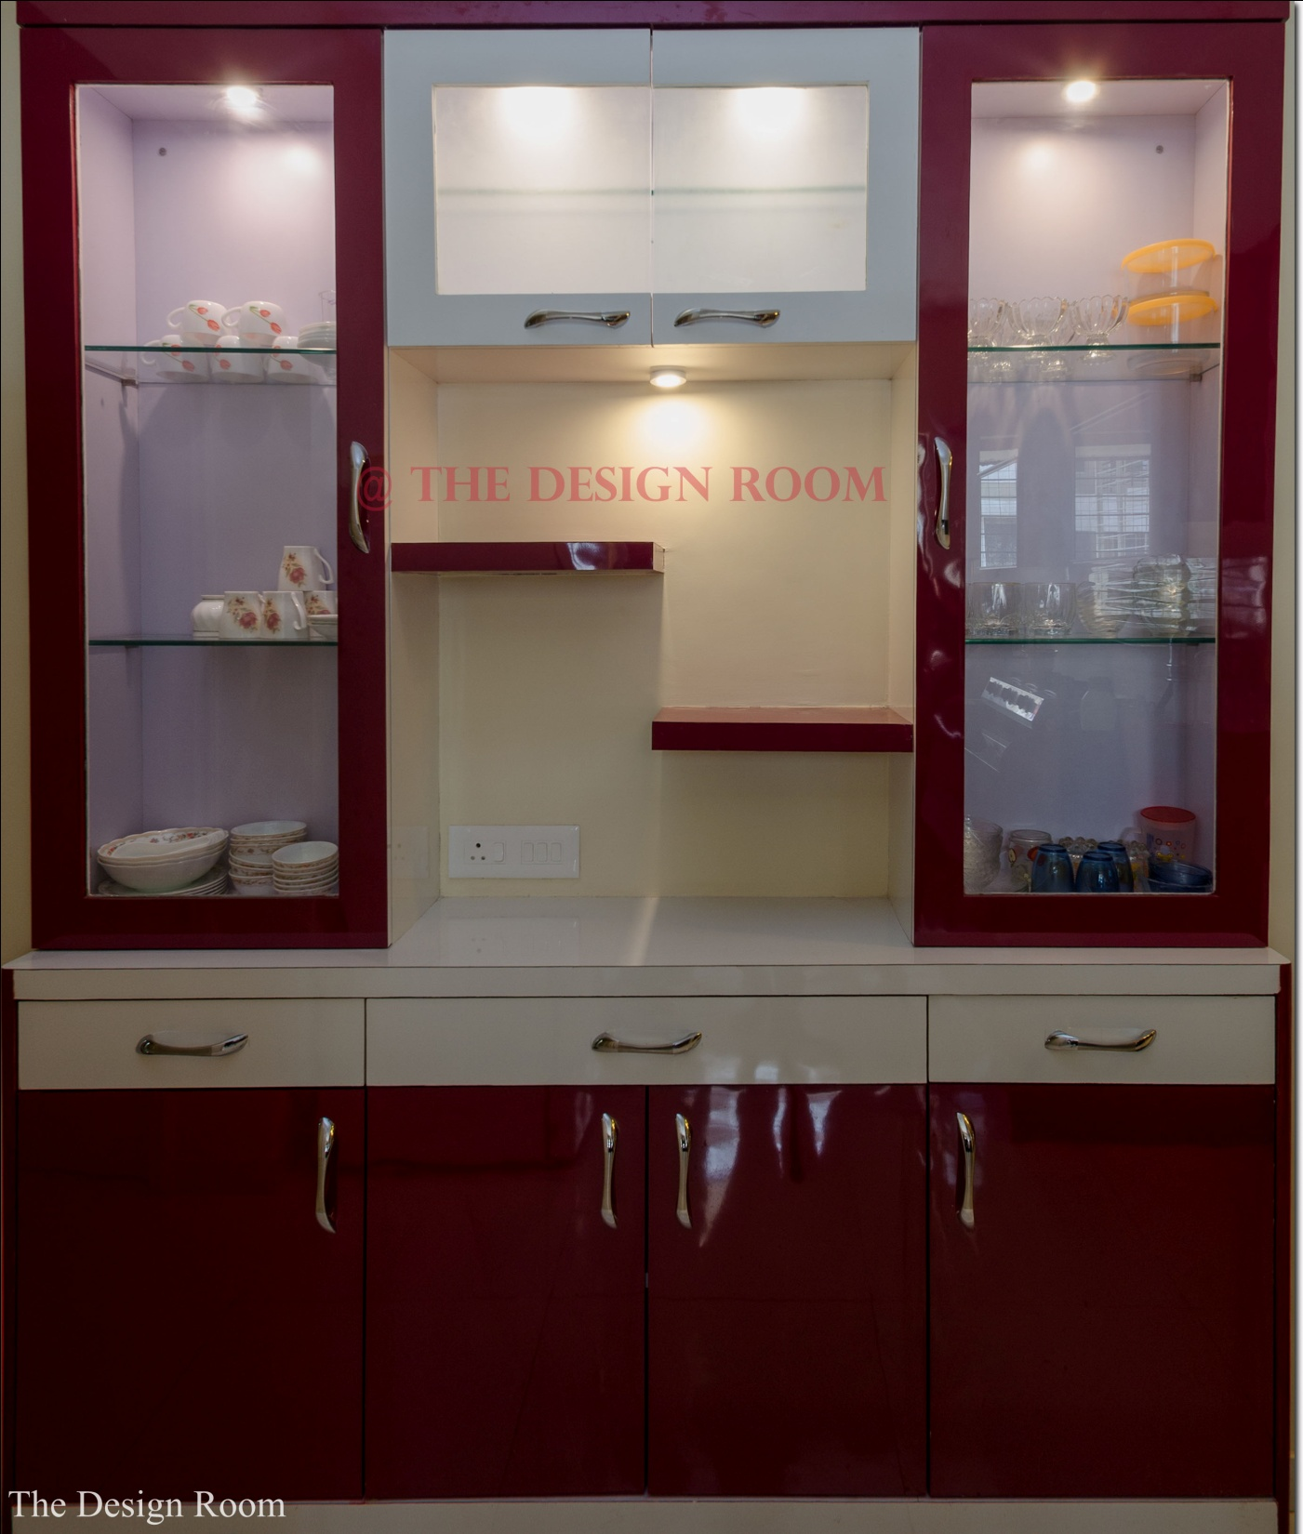

Slide 11
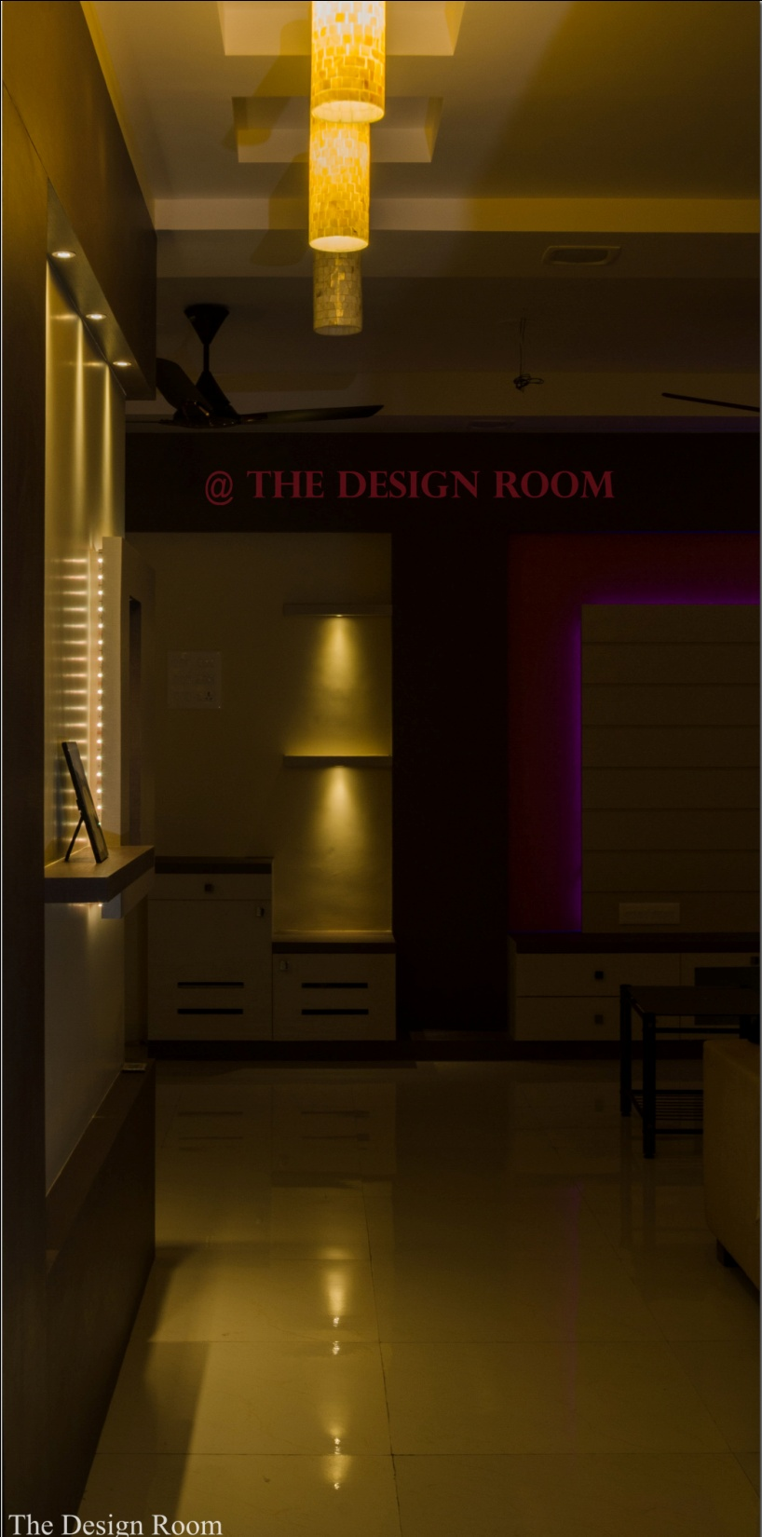

Slide 14
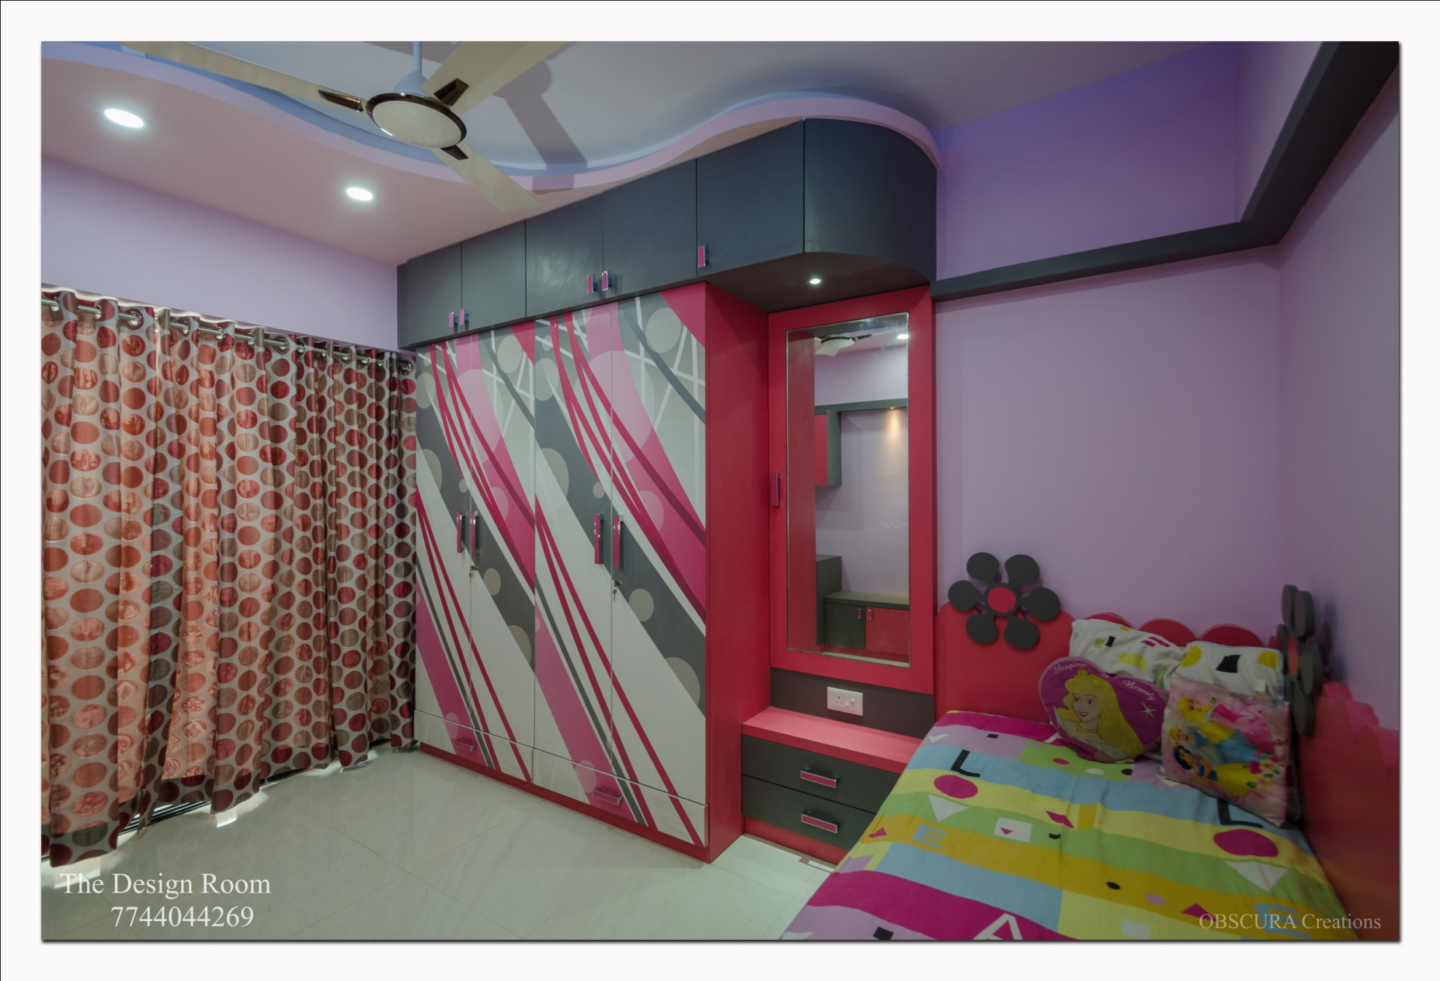

Slide 17
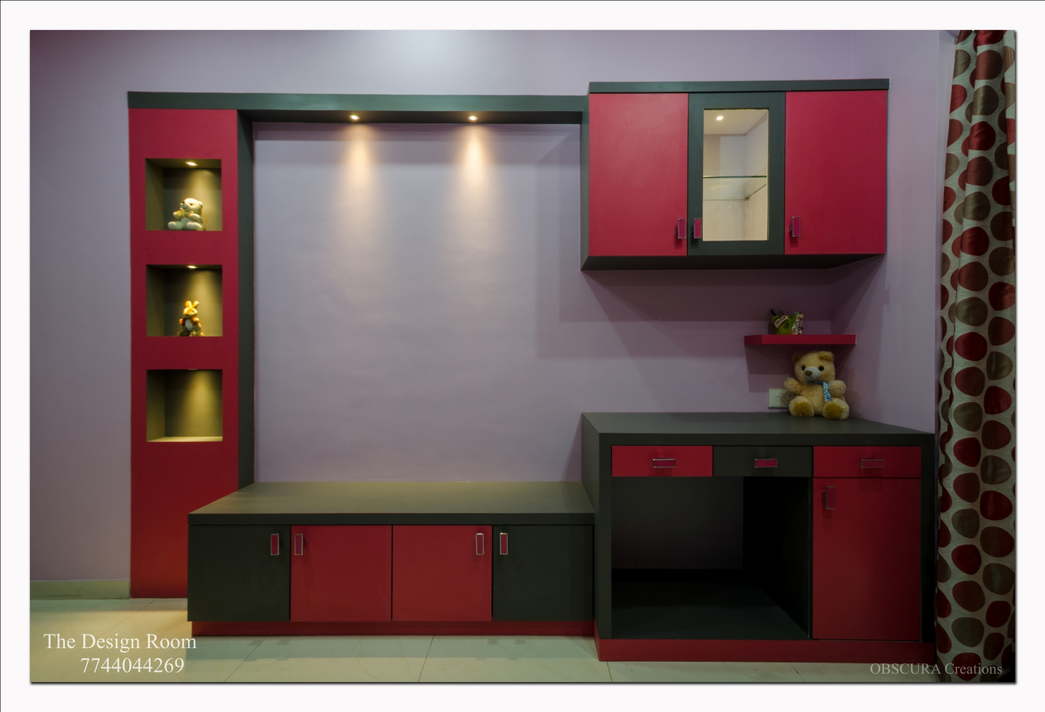

Slide 20
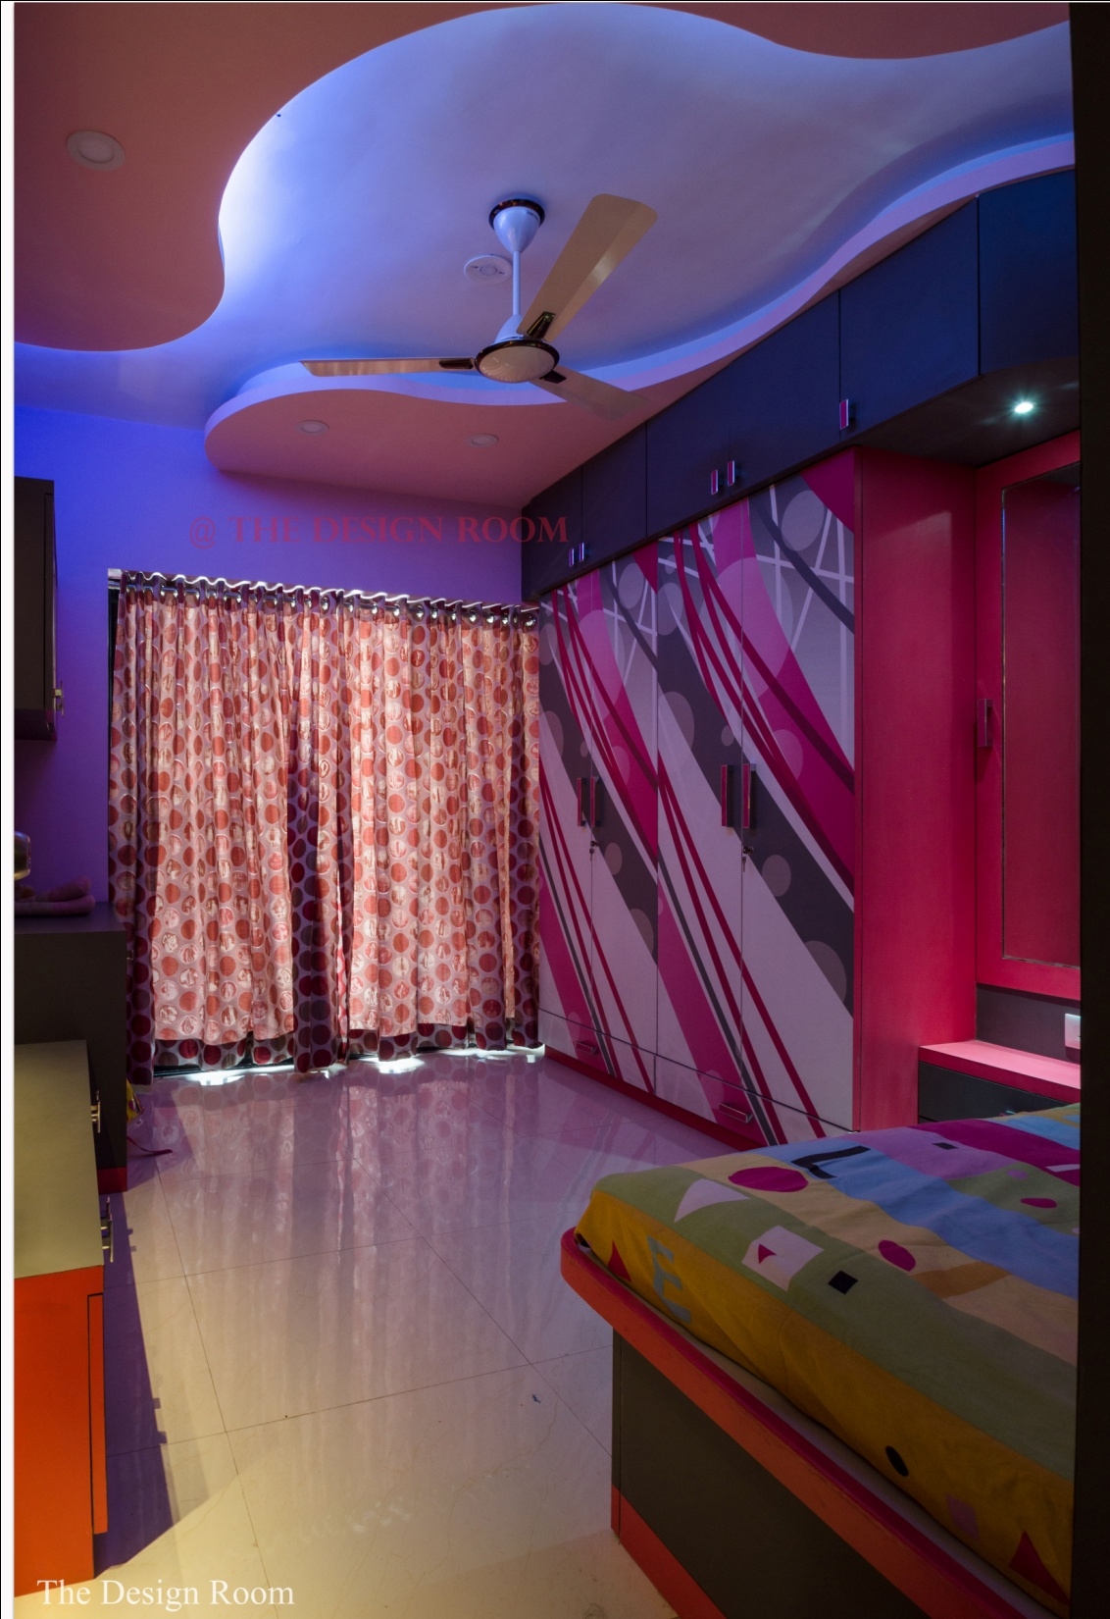

Slide 23
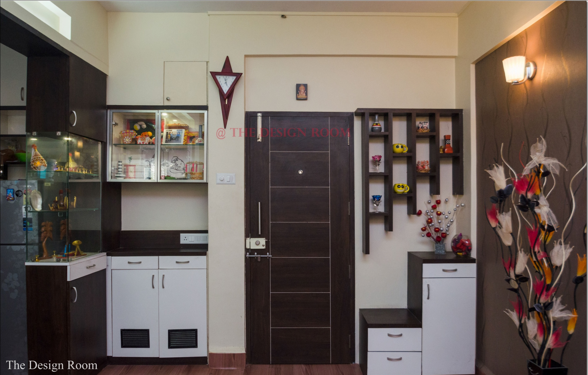

Slide 25
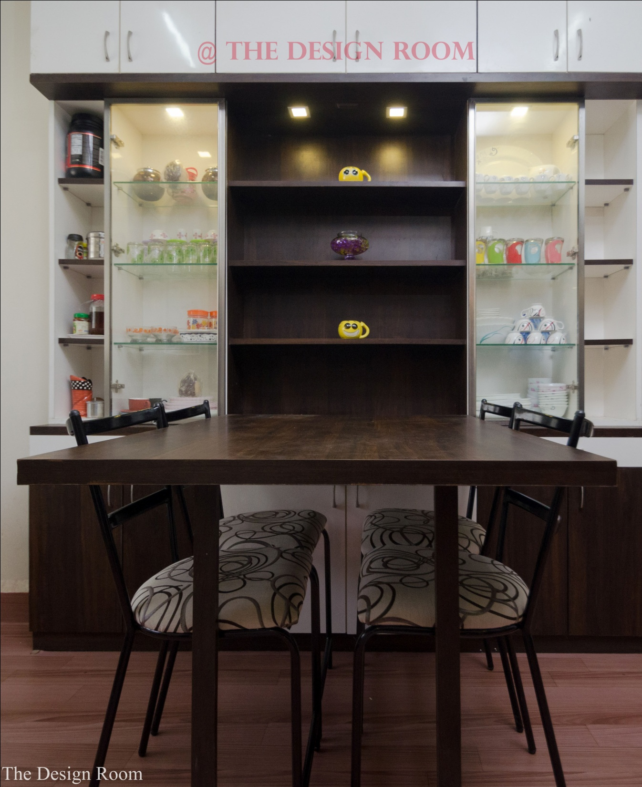

Slide 27
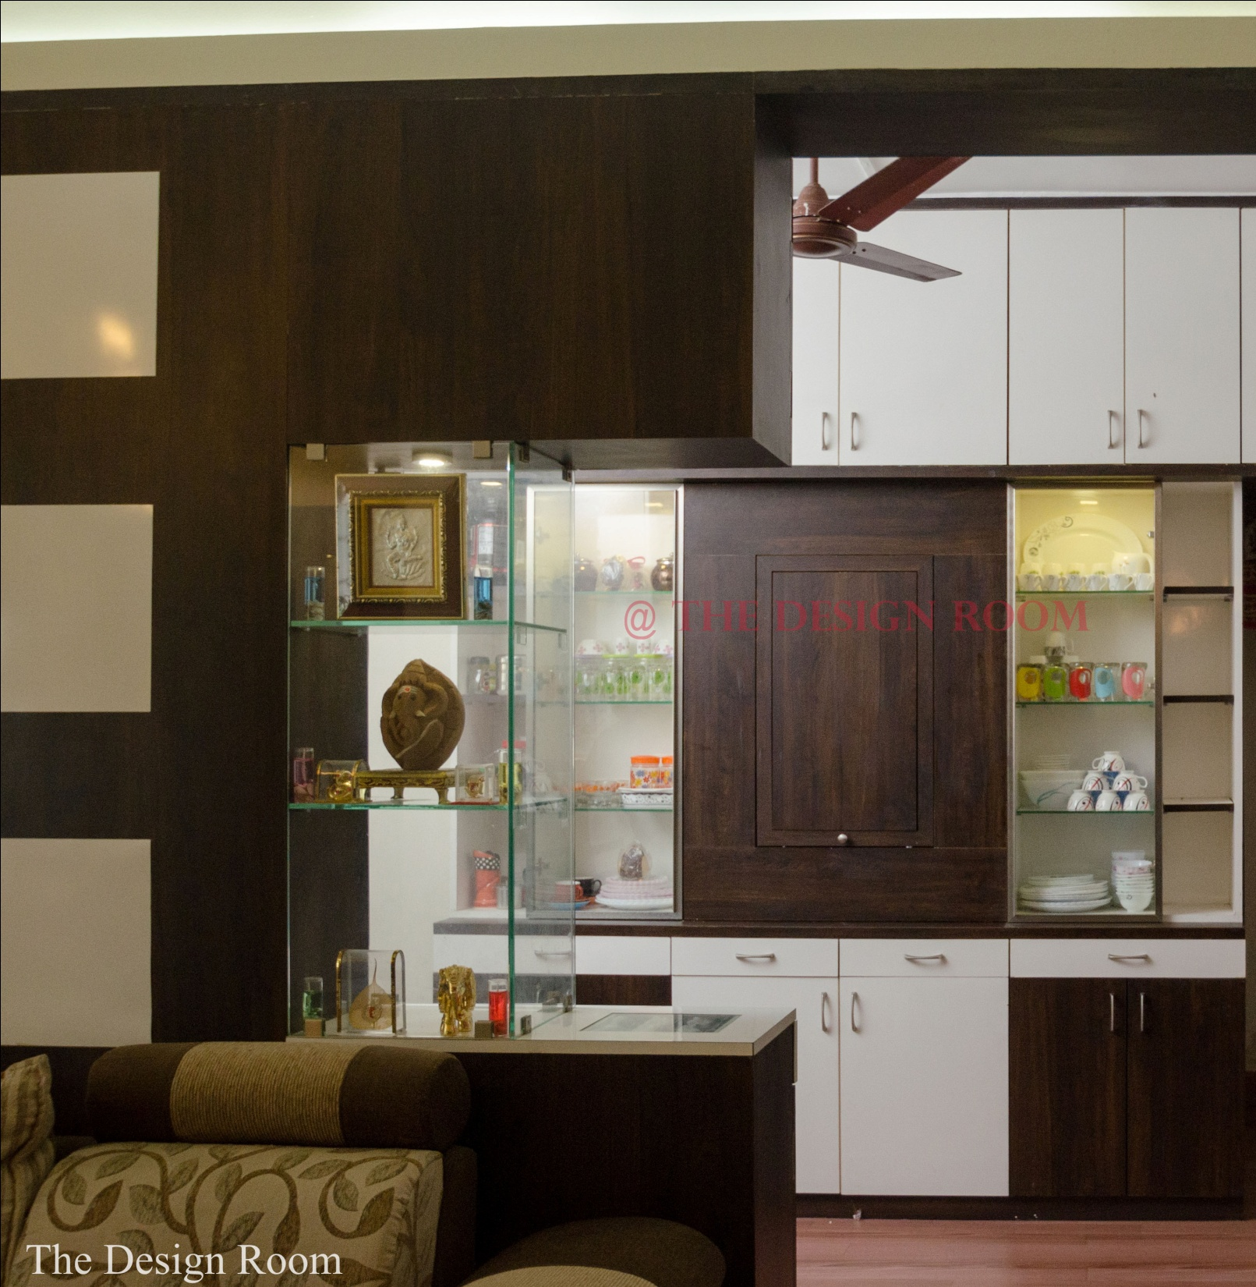

Slide 28
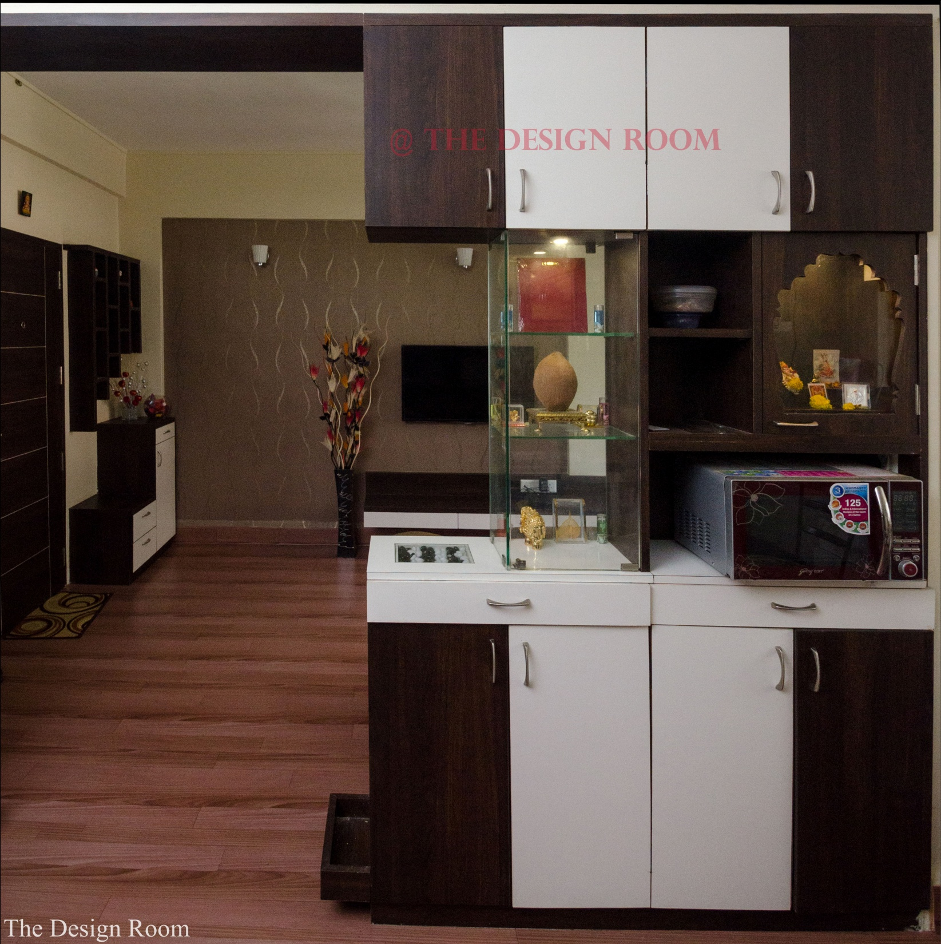

Slide 29


